Slide 1
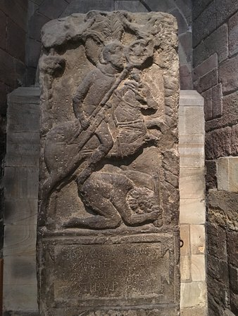
Poem as Inscription: Ezra Pound to Ian Hamilton Finlay
Rowena Fowler
University of Warwick
9 March 2019

Slide 2
Roman Epitaph in Hexham Abbey
Dis Manibus Flavinus
eq(ues) alae Petr(ianae) signifer
tur(ma) Candidi an(norum) XXV
stip(endiorum) VII h(ic) s(itus) (est)
To the Gods and the Shades.
Flavinus.
Standard-bearer. Petriana Horse.
White Troop. Age Twenty-Five.
Service Seven.
Lies Here.

Slide 4
Hrothgar’s inscribed sword
Hroðgar maðelode, hylt sceawode, ealde lafe, on ðæm wæs or written fyrngewinnes, syðþan flod ofsloh, gifen geotende, giganta cyn . . . Swa wæs on ðæm scennum sciran goldes þurh runstafas rihte gemearcod, geseted ond gesæd hwam þæt sweord geworht, irena cyst, ærest wære, wreoþenhilt ond wyrmfah. ða se wisa spræc sunu Healfdenes (swigedon ealle):
Beowulf, 1687–90; 1694–99

Slide 5
John Donne ‘A Valediction: of my name, in the window’
I
My name engrav’d herein,
Doth contribute my firmnesse to this glasse,
Which, ever since that charme, hath beene
As hard, as that which grav’d it, was;
Thine eye will give it price enough, to mock
The diamonds of either rock.
II
’Tis much that Glasse should bee
As all-confessing, and through-shine as I,
’Tis more, that it showes thee to thee,
And cleare reflects thee to thine eye.
But all such rules, loves magique can undo,
Here you see mee, and I am you.

Slide 6
Graffito on window at Jesus College, Cambridge, c. 1600

Slide 7
William Wordsworth ‘Written with a slate Pencil upon a Stone, the largest of a Heap lying near a deserted Quarry, upon one of the Islands at Rydal’
Stranger! this hillock of mis-shapen stones Is not a Ruin spared or made by time, Nor, as perchance thou rashly deem’st, the Cairn Of some old British Chief: ’tis nothing more Than the rude embryo of a little Dome Or Pleasure-house, once destined to be built Among the birch-trees of this rocky isle.
. . .
—if, disturbed By beautiful conceptions, thou hast hewn Out of the quiet rock the elements Of thy trim Mansion destined soon to blaze In snow-white splendour,—think again; and, taught By old Sir William and his quarry, leave Thy fragments to the bramble and the rose; There let the vernal slow-worm sun himself, And let the redbreast hop from stone to stone.

Slide 8
Keats’s grave in Rome
Here lies One Whose Name was writ in Water

Slide 9
Ezra Pound, ‘Stele’ (Moeurs contemporaines, VI)
After years of continence he hurled himself into a sea of six women. Now, quenched as the brand of Meleager, he lies by the poluphloisboious sea-coast.
παρὰ θῖνα πολυϕλοίσβοιο Θαλάσσης
SISTE VIATOR

Slide 10
Ezra Pound’s inscribed oars
‘But thou, O King, I bid remember me, unwept, unburied
‘Heap up mine arms, be tomb by sea-bord, and inscribed:
‘A man of no fortune, and with a name to come.
And set my oar up, that I swung mid fellows.’
(Canto I / 3–4; cf Odyssey 11. 21–78)
Then on an oar
Read this:
‘I was
And I no more exist;
Here drifted
An hedonist.’
(‘Mauberley’, IV)

Slide 11
Cavafy

Slide 12
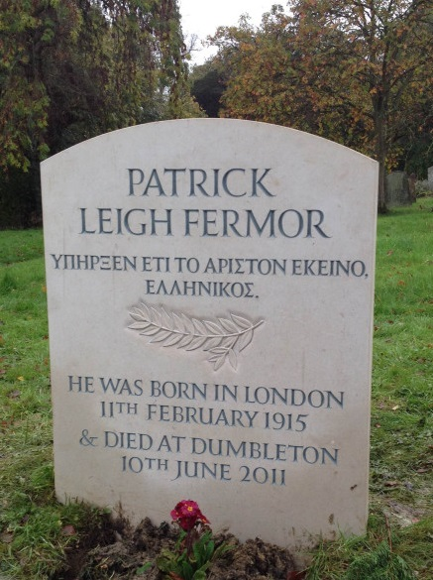

Slide 13
Under bare Ben Bulben’s head In Drumcliff churchyard Yeats is laid. An ancestor was rector there Long years ago; a church stands near, By the road an ancient Cross. No marble, no conventional phrase; On limestone quarried near the spot By his command these words are cut:
Cast a cold eye On life, on death, Horseman, pass by!
September 4, 1938
(W. B. Yeats, ‘Under Ben Bulben’, VI)

Slide 14
Roman tile from Silchester
Pertacus Perfidus
Campester Lucilianus Campanus conticuere omnes
Pertacus, Perfidus,
Campester, Lucilianus,
Campanus: they all fell silent.

Slide 15
from U.A. Fanthorpe, ‘The Silence’
They came too near the dark, for all their know-how. Those curses they scratched widdershins on lead — Asking for trouble. We withdrew into the old places, that are easier To believe in. Once we waited For someone to come back, But now it’s clear they won’t. Here we stand, Between Caes. Div. Aug. and the next lot, expert only At unspeakable things, Stranded between history and history, vague in-between people. What we know will not be handed on. Conticuere omnes.

Slide 16
Ian Hamilton Finlay, wood carving ‘Even gods have dwelt in woods’
Habitarunt di quoque silvas (Virgil, Eclogues 2. 60)

Slide 17
Ian Hamilton Finlay, stone and steel ‘The world has been empty since the Romans’

Slide 18
Geoffrey Hill, ‘Sorrel’
Very common and widely distributed . . .
It is called sorrow . . . in some parts of Worcestershire.
Memory worsening — let it go as rain streams on half-visible clatter of the wind lapsing and rising, that clouds the pond’s green mistletoe of spawn, seeps among nettle-beds and rust-brown sorrel, perpetual ivy burrowed by weak light, makes carved shapes crumble: the ill-weathering stone salvation’s troth-plight, plumed, of the elect.

Slide 19
Poem as Inscription: Ezra Pound to Ian Hamilton Finlay
Rowena Fowler
University of Warwick
9 March 2019

